Slide 1
Application Insights Overview
Name

Slide 2
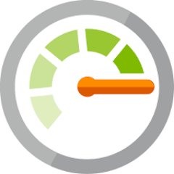
Azure Monitor
Full observability for your infra, app and network
Metrics
Logs
Common Store
Unified Monitoring
Data Driven Insights
Workflow Integrations
A common platform for all metrics, logs and other monitoring telemetry
Advanced diagnostics and analytics powered by machine learning capabilities
Rich ecosystem of popular DevOps, issue management, SIEM, and ITSM tools

Slide 3
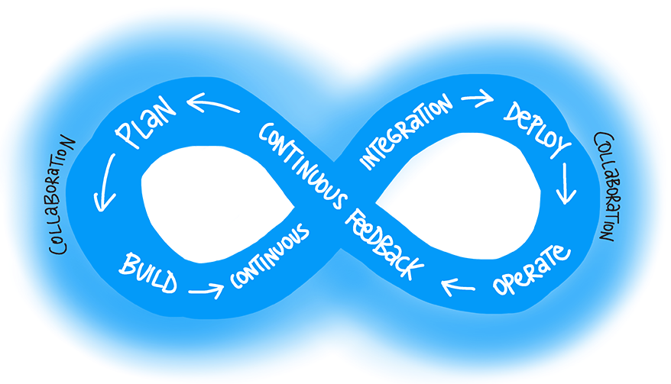
Continuous Monitoring in your DevOps Cycle
Customer Feedback
+
Continuous Monitoring
[1] From Sam Guckenheimer’s “What is DevOps”

Slide 4
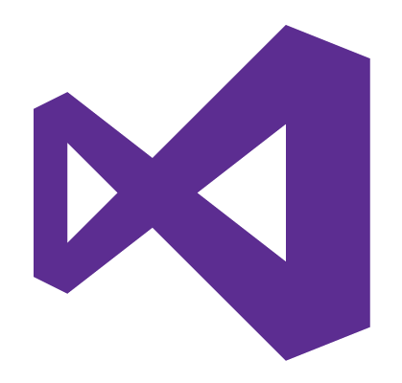
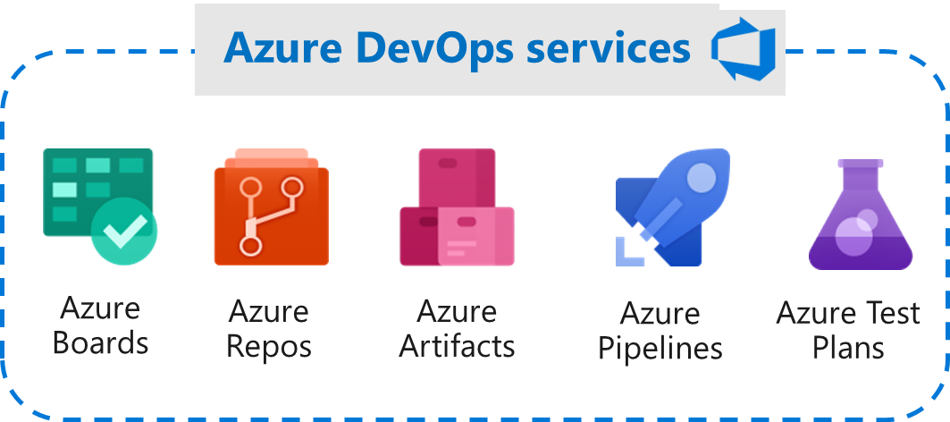
Continuous Monitoring (CM) for DevOps
Visual Studio & Visual Studio Code
Azure Monitor
Plan & Track
Develop
Build & Test
Deploy
Operate
Monitor & Learn

Slide 5
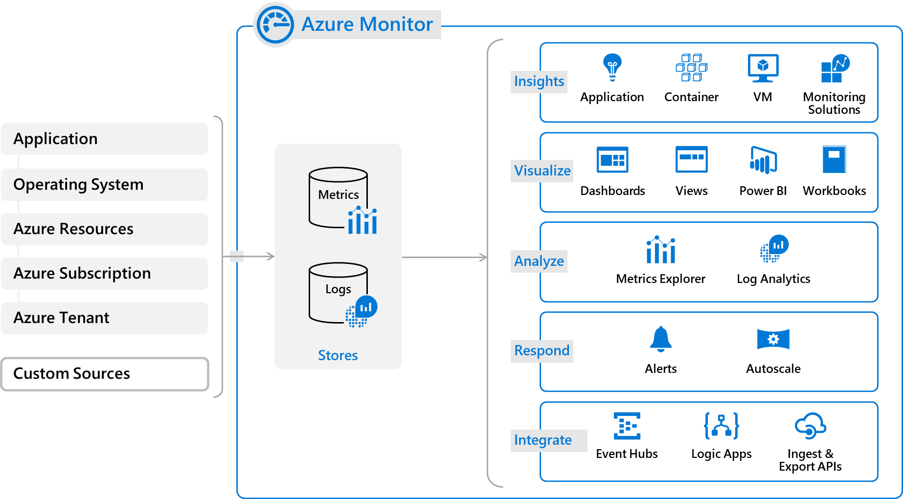

Slide 6
Application Insights

Slide 7
Application monitoring and analytics
Visibility
Insights
Optimization
Get the big picture
Find & fix problems
Build, measure, learn

Slide 8

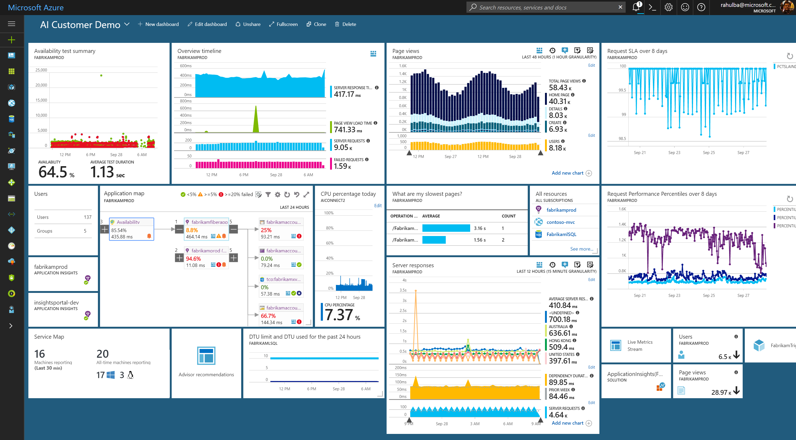
Azure Application Insights
Visibility – Get the big picture
Monitoring across App & Infra
Alerts & Notifications
Visualization & Collaboration
Insights – Find & fix problems
Detect, Diagnose & Debug Failures
Advanced Analytics with ML
Setup automated actions
Optimization – Build, measure, learn
Performance Optimization & Profiling
User Behaviour & Customer Insights
Impact Correlation

Slide 9

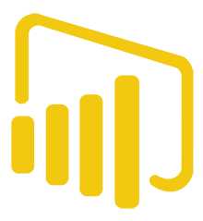

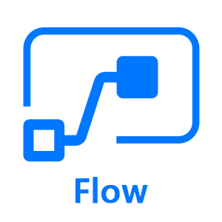
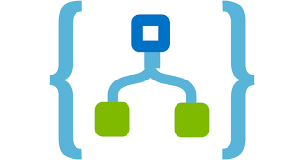

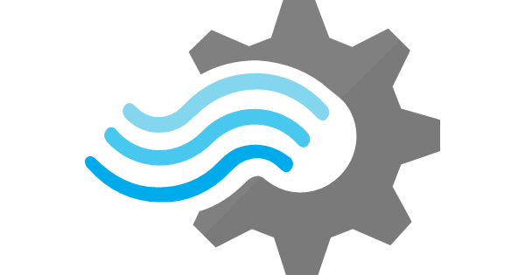



Application Insights ecosystem
Ingestion
Exploration
Export & Correlation
Application Insights
Microsoft Azure Portal
OMS Connector
Power BI
Open Source SDKs
Status Monitor
Azure Extensions
Azure Monitor
Application Map
Live Metrics Stream
Profiler & Debugger
Microsoft Flow
Logic Apps
Blob storage
Stream Analytics
SCOM MP
VS App Center
Open Schema
Visual Studio Team Services
Visual Studio IDE
Analytics Portal
Data Access REST APIs
Support (Cloud/On-Premises/Hybrid)
Officially Supported
C#/VB.NET
Java
JavaScript
Node.JS
Public Endpoints
Community Supported
PHP
Python
Ruby
Platforms & Frameworks
ASP.NET & Core
J2EE
Android & iOS
Azure App & Cloud Services
Azure Functions
Azure Service Fabric
Docker & Kubernetes
CMS
Drupal
Joomla
SharePoint
WordPress
Orchard
Logging Frameworks
Log4Net & NLog
Log4J & Logback
System.Diagnostics
Semantic Logging (SLAB)

Slide 10
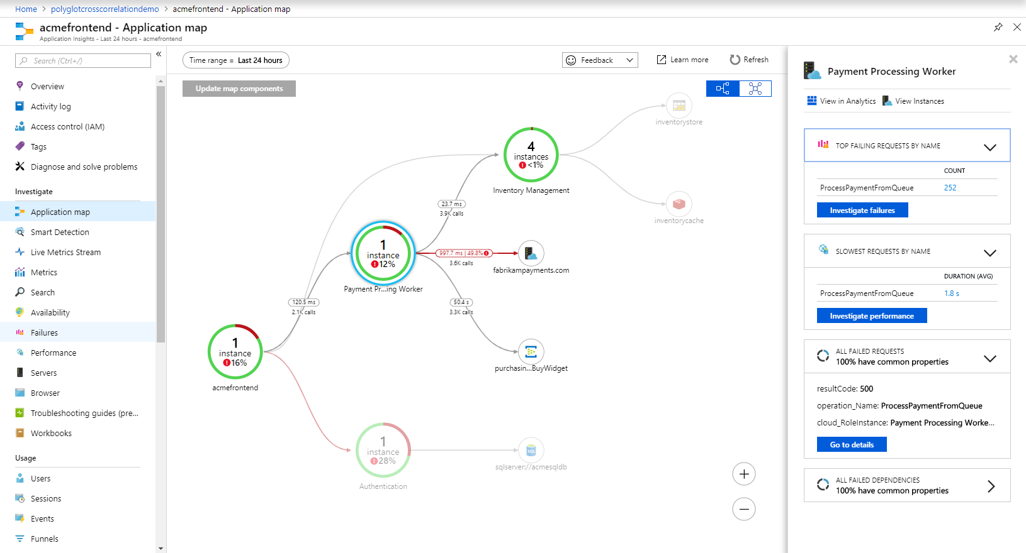
Diagnose E2E issues with Application Insights
Monitor apps in .NET, JS, Java, Node.js or any language with OSS SDKs NEW!
Visualize server/client connections & dependencies with App Map
Track E2E distributed transactions (including for Python & Go) NEW!
Drill down to code-level with Snapshot Debugging & Profiling
Understand end-user cohorts, behavior & engagement for planning

Slide 11
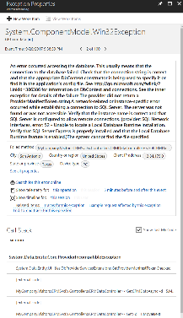
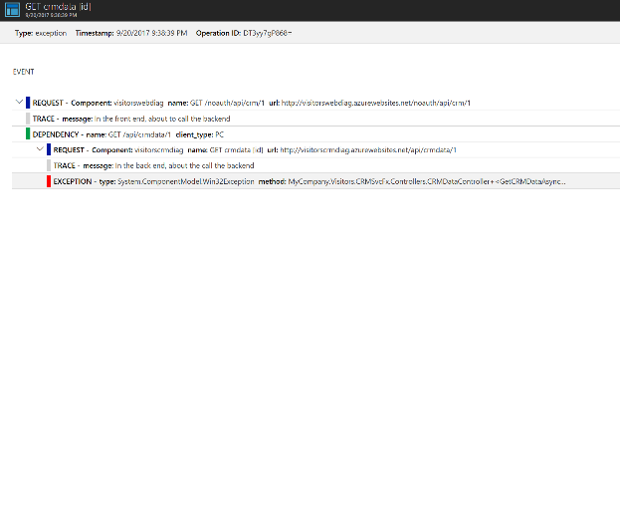
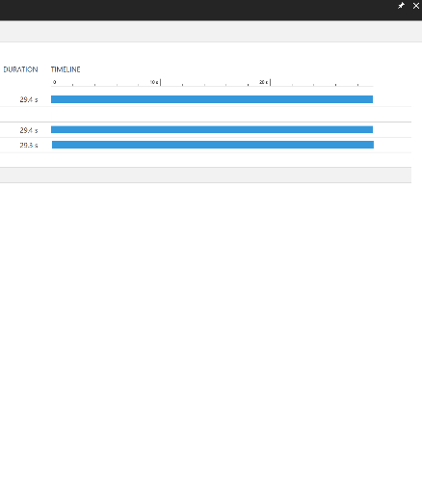
Correlated tracing across servers

Slide 12
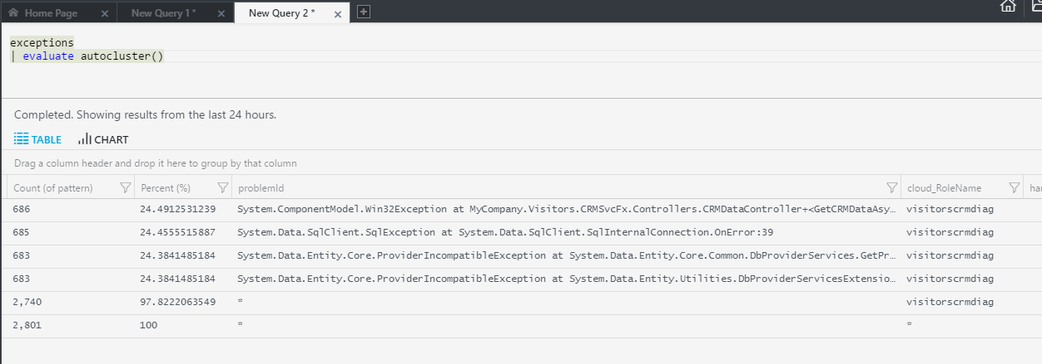
Using Analytics to Dig Deeper

Slide 13
Optimizing Performance
Deliver a great user experience: <500ms
Minimize cost of cloud resources
Overall minimize what code is doing over time:
Request:
Code waiting
0ms
Network
Process Inputs
Make DB or HTTP Call
Process Results
Return Results
1000 ms
Code executing on CPU
Second Request:
Done using CPU
Done using CPU
Resource Contention
0ms
Network
Process Inputs
Make DB or HTTP Call
Process Results
Return Results
1200 ms

Slide 14
Scenarios
Performance issues that affect every request
Entity Framework
CSHTML rendering
Blob store/http calls/etc.
Performance issues that happen at scale or infrequently
Resources overutilized
Garbage collection
Lock/resource contention

Slide 15
Application Insights Profiler
Helps you see what code is doing over time
Captures data from production
Samples 2 minutes/hour
Capture all requests that happen during that time
Data is stored for 5 days
Segments results into typical vs. long tail (median, 95th)

Slide 16
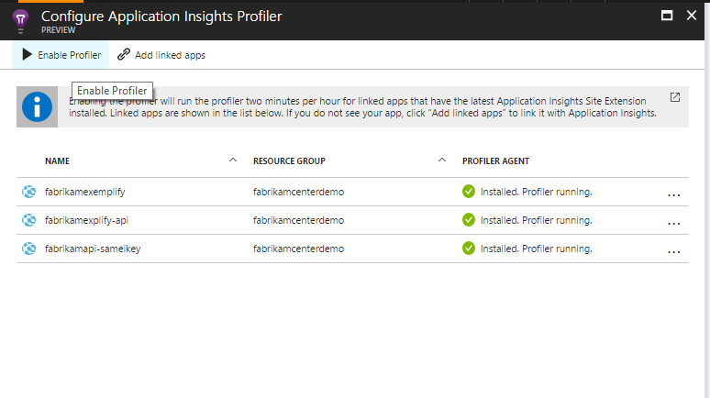
Enable Profiler from Performance Blade
Requirements:
.NET Framework 4.6
.NET Core on Windows
GA for Azure App Service
Preview Available for Compute (VMs, Service Fabric, Cloud Services)

Slide 17
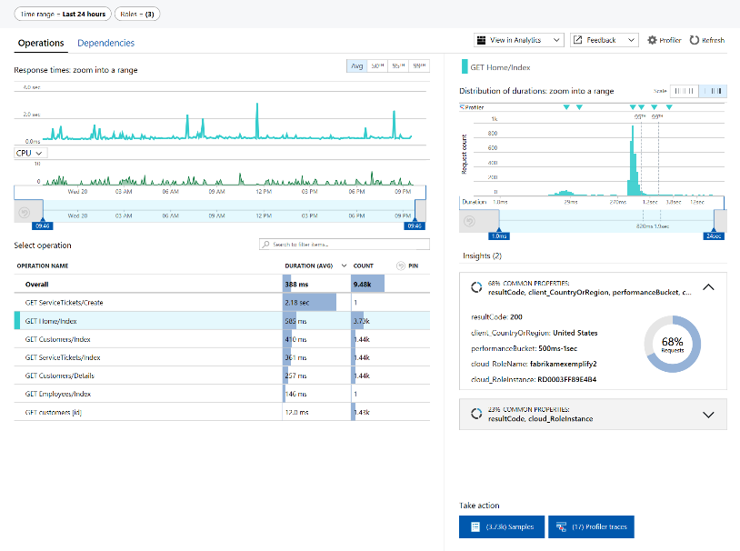
Prioritize Operations by Looking at Percentiles

Slide 18
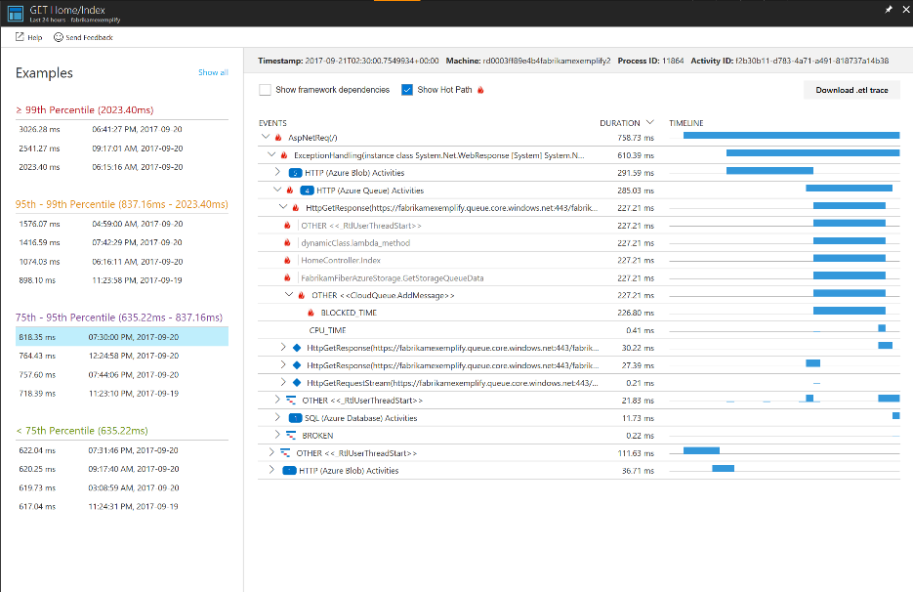
Drill Into Example Requests

Slide 19
Application Insights: Recap
Get the big picture
Find & fix problems
Build, measure, learn
Azure Metrics & Dashboards
Alerts & Notifications
Synthetic Monitoring
Live Metrics Stream
Application Map v2 NEW!
Workbooks NEW!
Flow/Logic Apps Integration
VSTS/RM Integration NEW!
Data Access APIs & Export
Smart Detection
E2E Transaction Tracing NEW!
Failure Diagnostics & Snapshot Debugging
VS CodeLens Integration
Advanced Analytics with Machine Learning
Azure Monitor Auto-scaling
Performance Monitoring & Profiling
Custom Instrumentation
User/Session/Event Monitoring
Cohorts & Funnels
Customer Retention
User Flows
Impact Correlation NEW!

Slide 20
Azure Monitor Roadmap
Rich insights for Azure Storage, SQL & Service Fabric Mesh
RBAC per data type in Log Analytics
Support for containers on demand for AKS with virtual nodes
Support live logs for containers and Kubernetes events
Smart detections and alerts with Dynamic Thresholds
Expanded Azure support and interoperability for Distributed Tracing
Exception tracking and custom metrics for Python and Go apps
Auto enablement of app monitoring for App Services / Windows VMs (with WAD)
Expanded region availability across public & sovereign clouds
Latency improvements for Alerts, Logs & Metrics

